Slide 1
PZAD. Homework base on result of the lecture 2
Urvanov Egor
24 september 2018

Slide 2
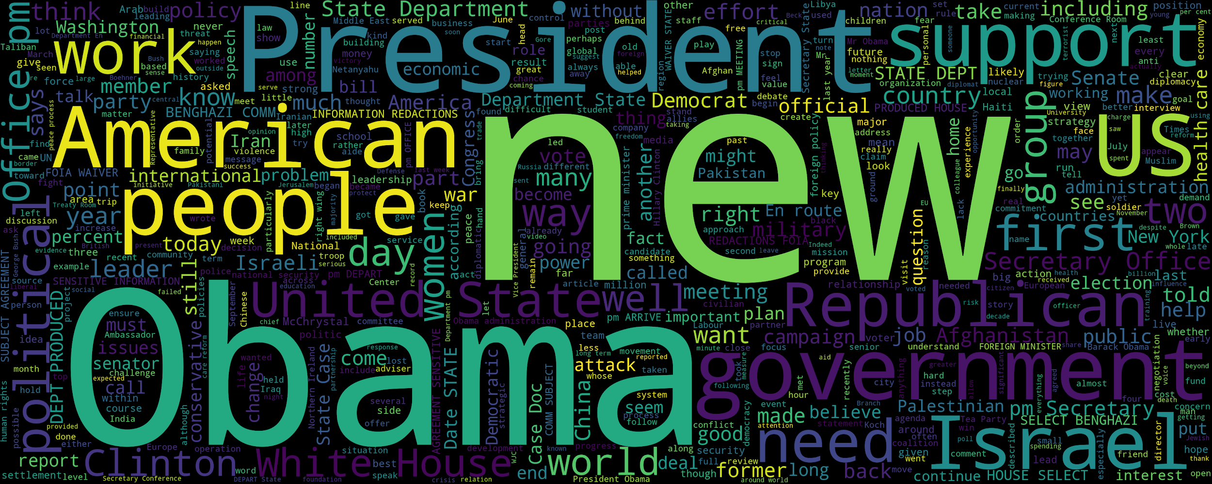

Slide 3
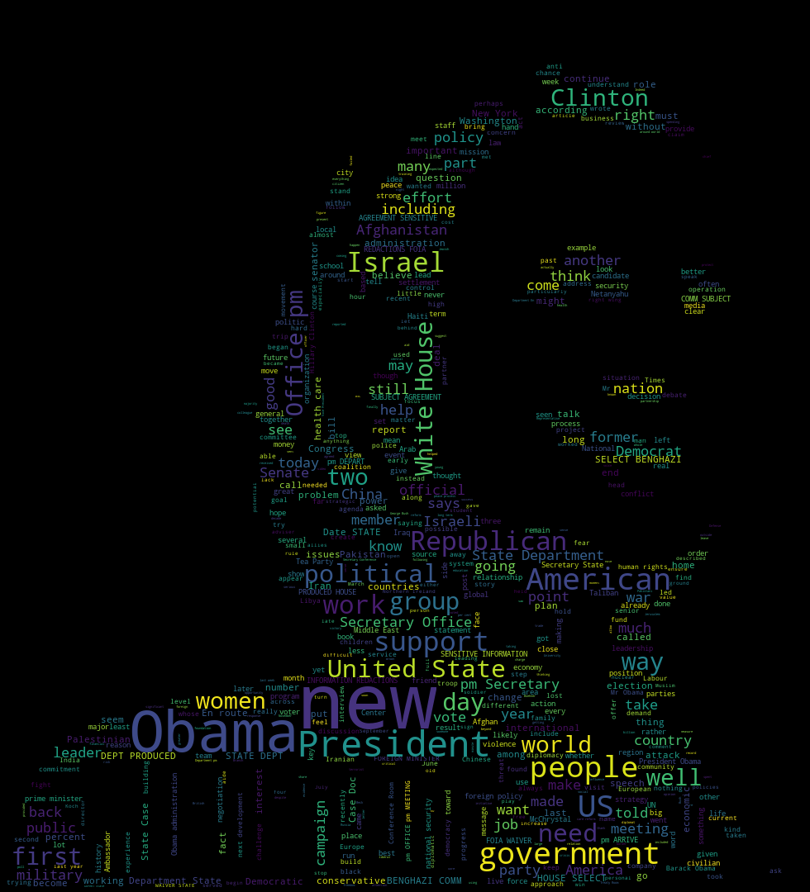

Slide 4

The most popular words in the publicized correspondence of Hillary Clinton

Slide 5
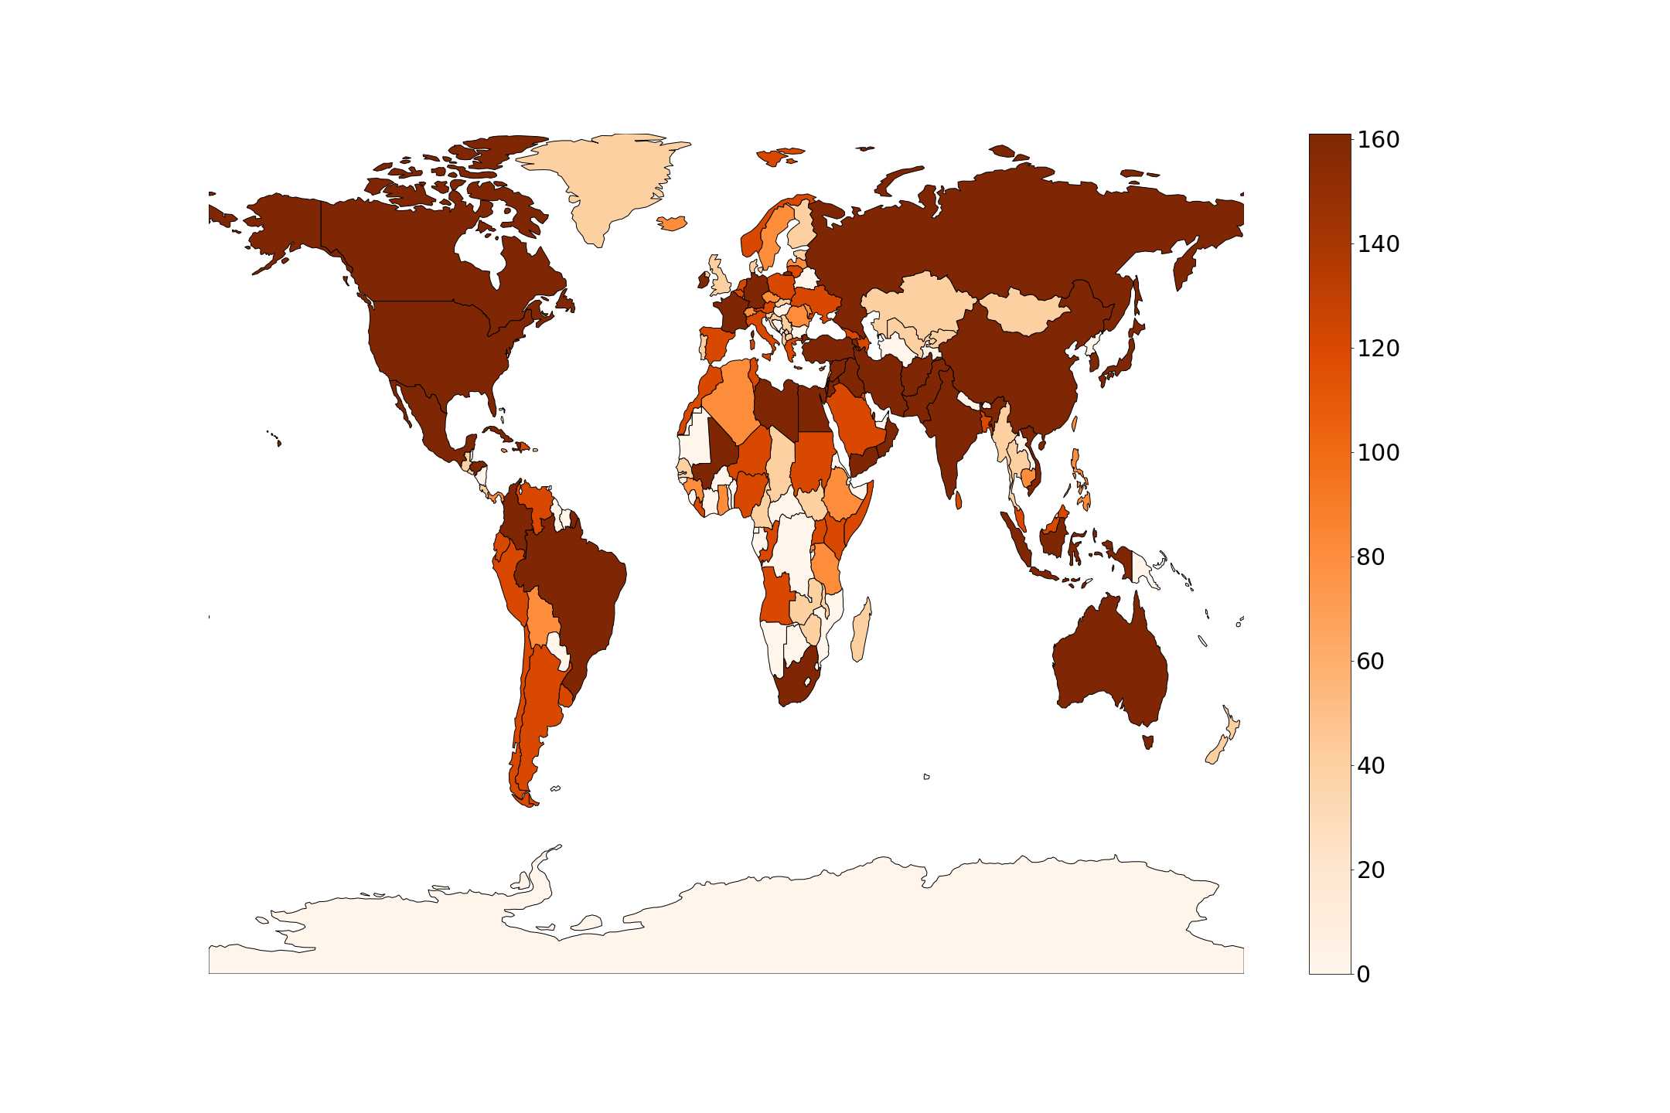

Slide 6


Slide 7
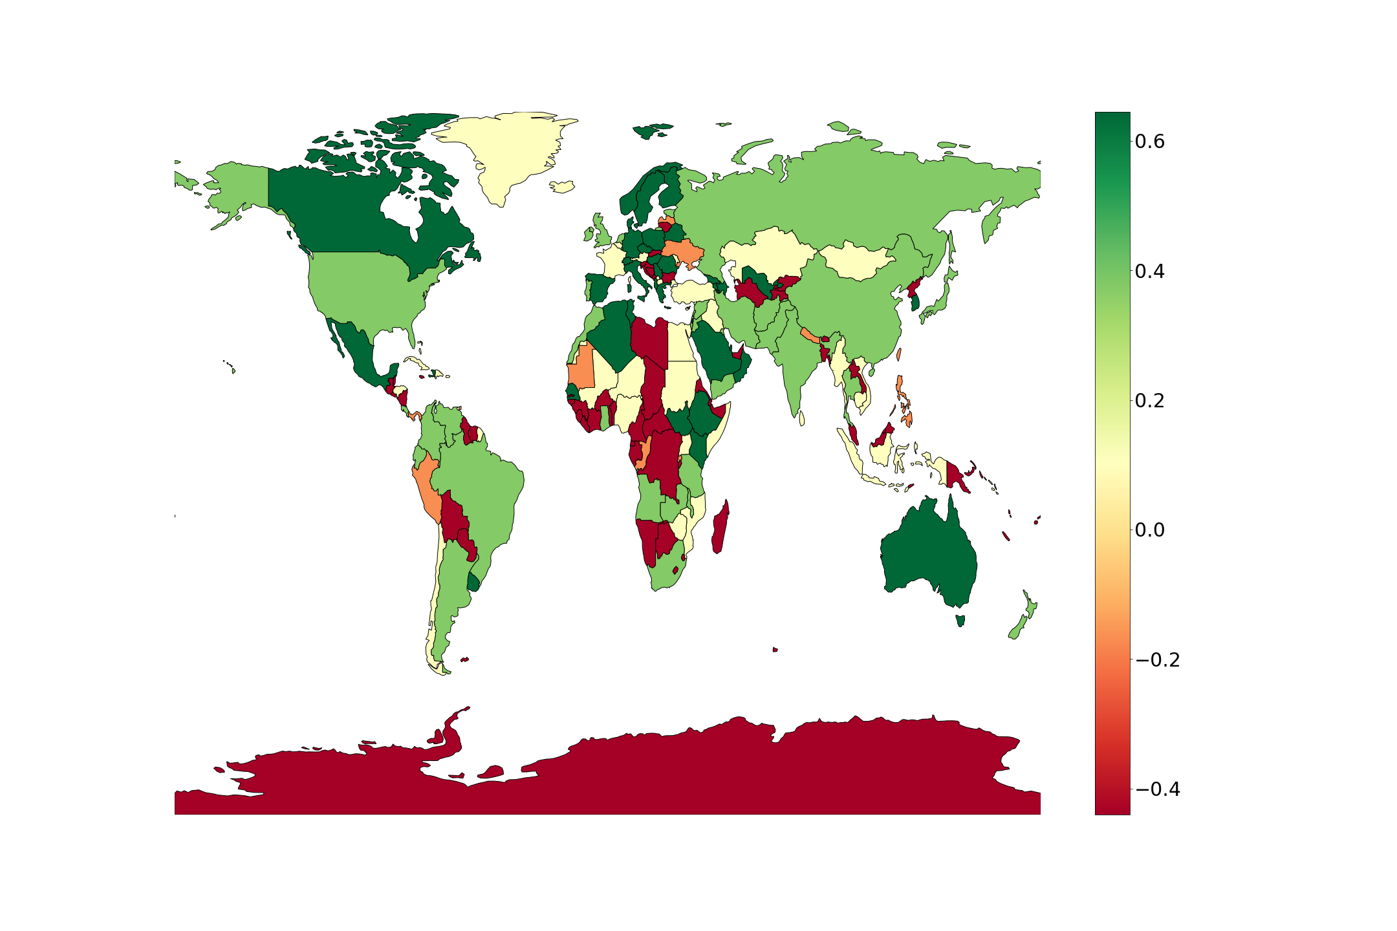

Slide 8
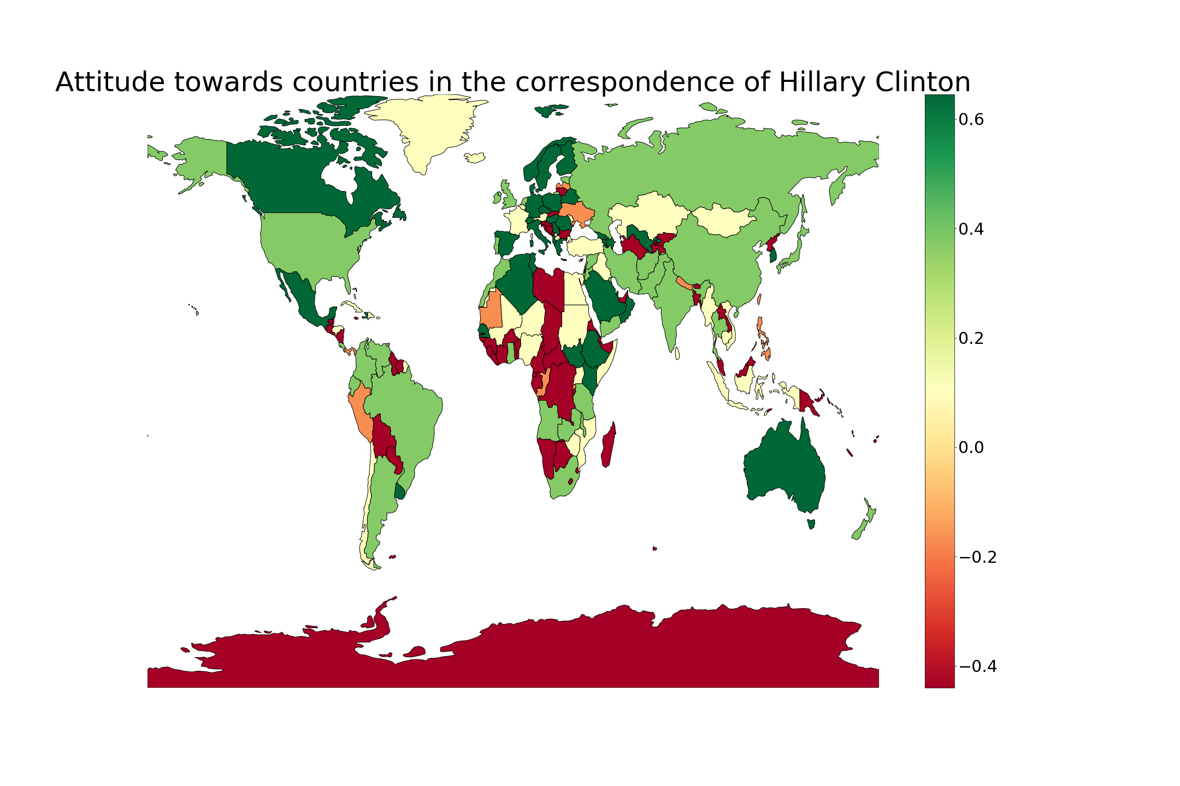

Slide 9
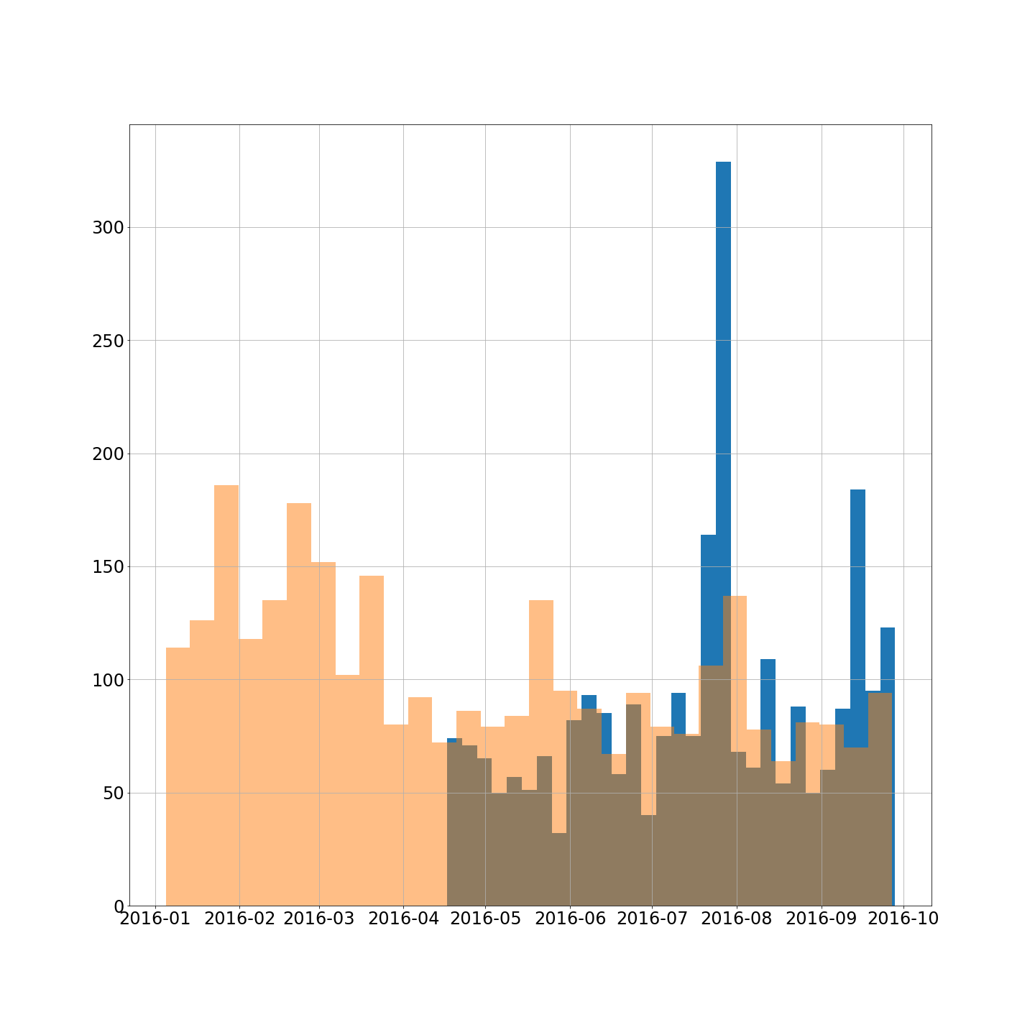

Slide 10
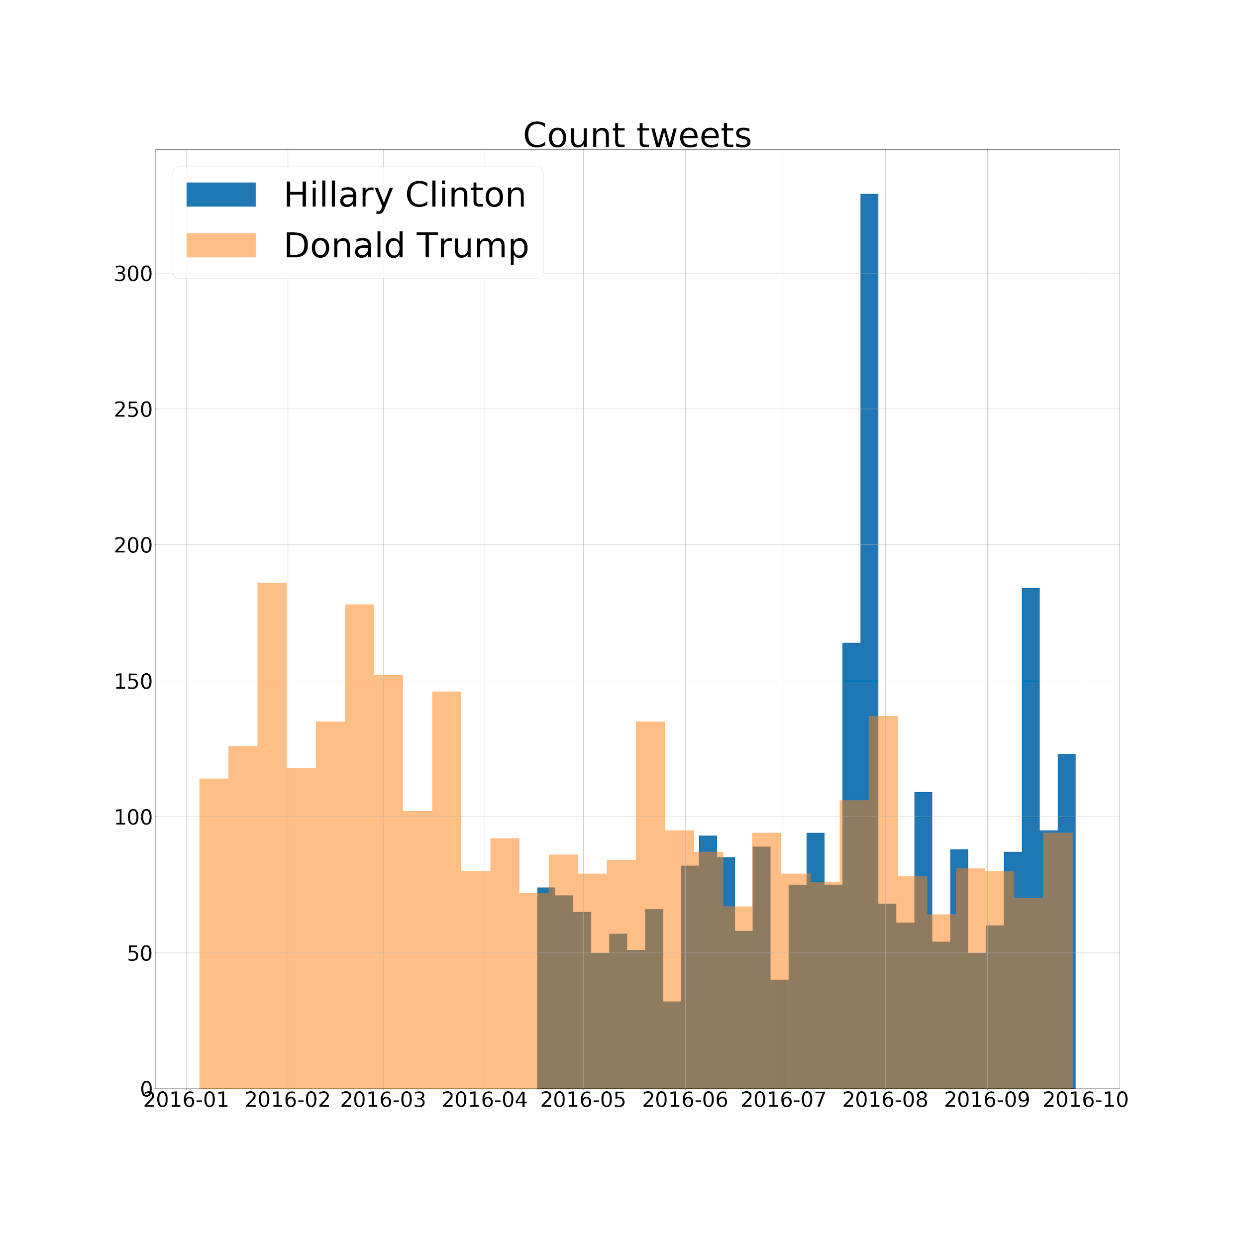

Slide 13
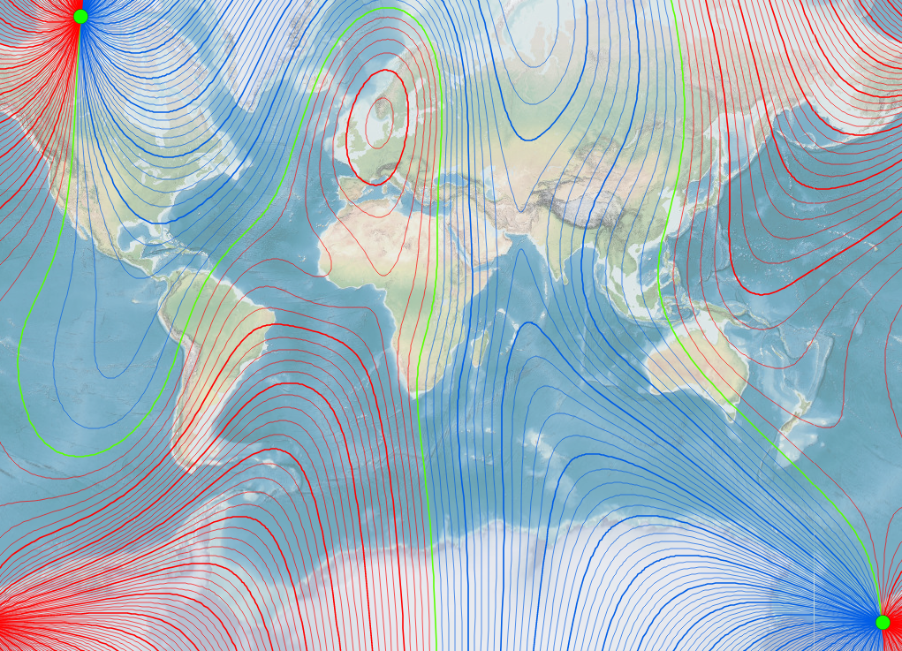
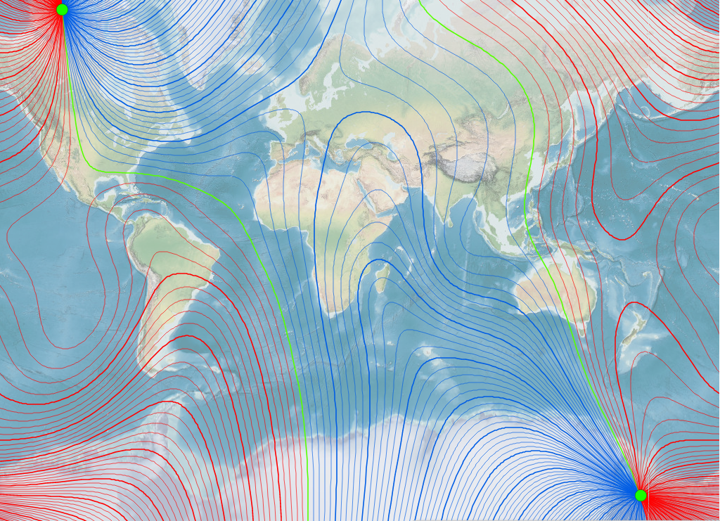
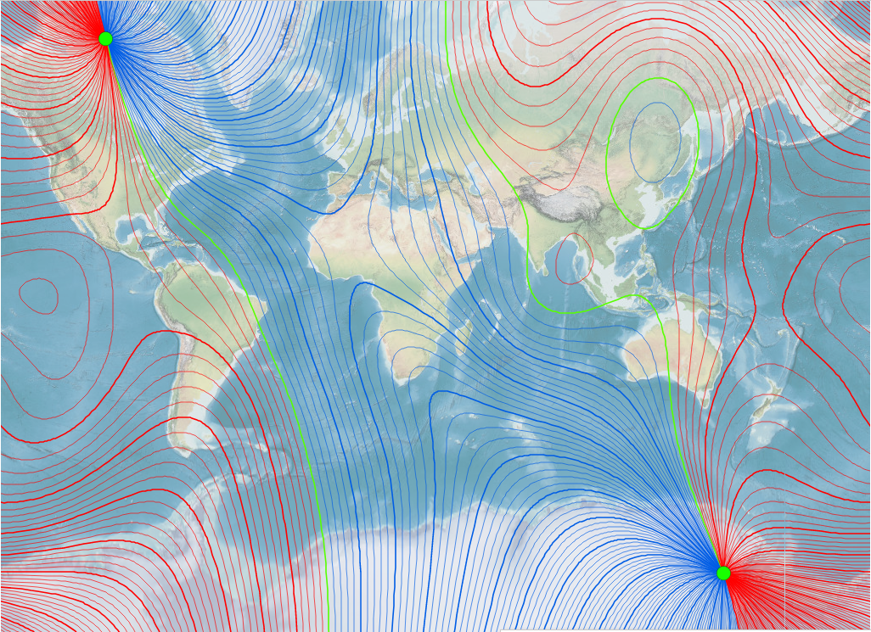
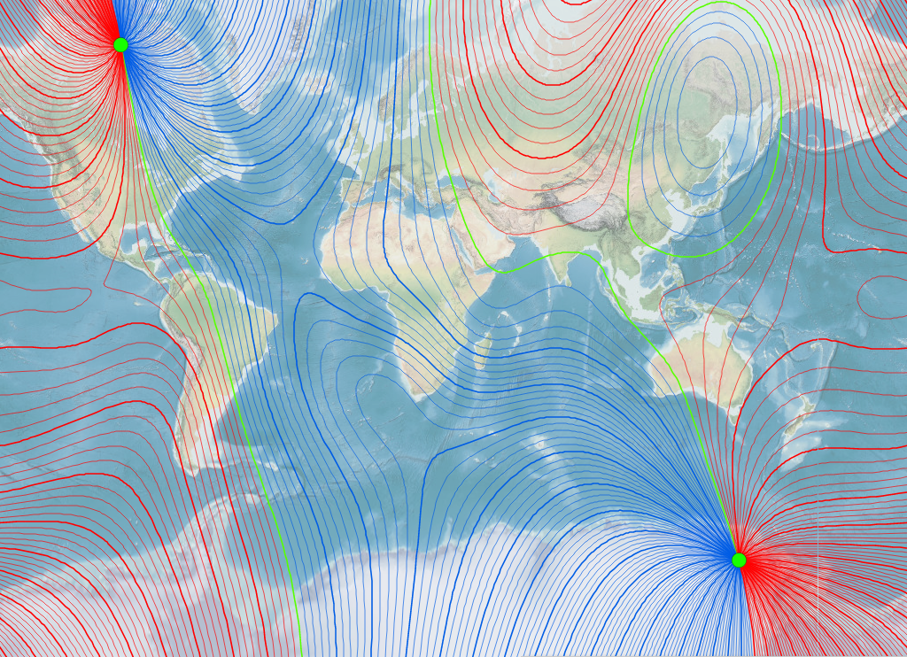
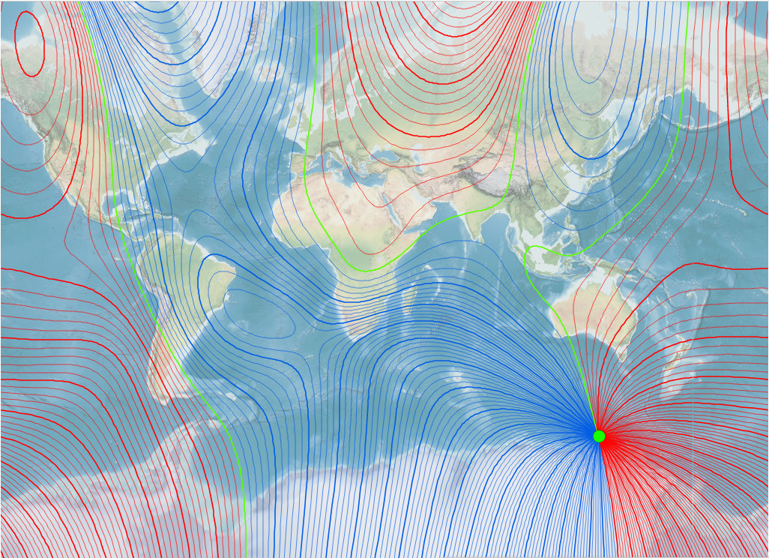

Slide 14
1600 year
1700 year
1800 year
The motions of the Earth’s magnetic poles
1900 year
2020 year

Slide 15
Sources
https://www.kaggle.com/mrisdal/2016-us-presidential-debates
https://www.kaggle.com/benhamner/clinton-trump-tweets
https://maps.ngdc.noaa.gov/viewers/historical_declination/
https://github.com/Hedgehogues/MSU_PZAD

